Slide 1
COMPANY PROFILE
Tan Hoang Linh Co.ltd
CÔNG TY TNHH XÂY DỰNG VÀ QUẢNG CÁO TÂN HOÀNG LINH

Slide 2


BRIEF INTRODUCTION
TAN HOANG LINH CONTRUCTIONS & ADVERTISING CO.,LTD
Transaction Name: THL
Foundation Year: 09/2002
Business License Number: 0102006330
Tax Number: 0101288673
Director: Tô Quang Thắng (Mr)
Filed of Business: Constructions, Advertising, Exhibition, Décor ,…
Hotline: 0966 093 685 – 091 355 1184

Slide 3
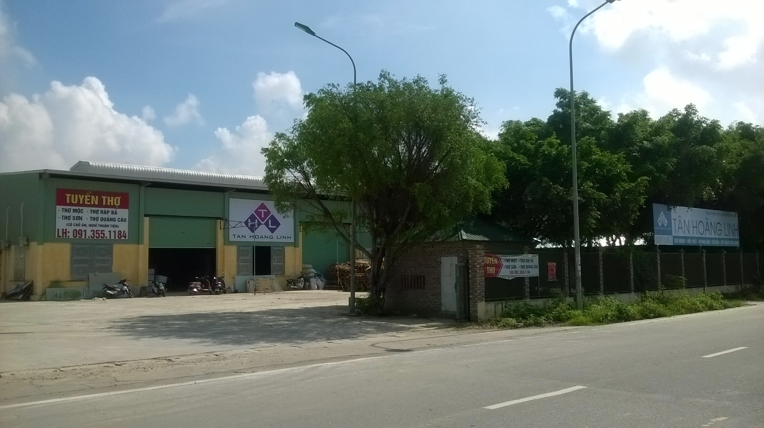
HANOI WORKSHOP
Workshop: Km14 Thang Long Avenue – Hoai Duc District - Hanoi

Slide 4
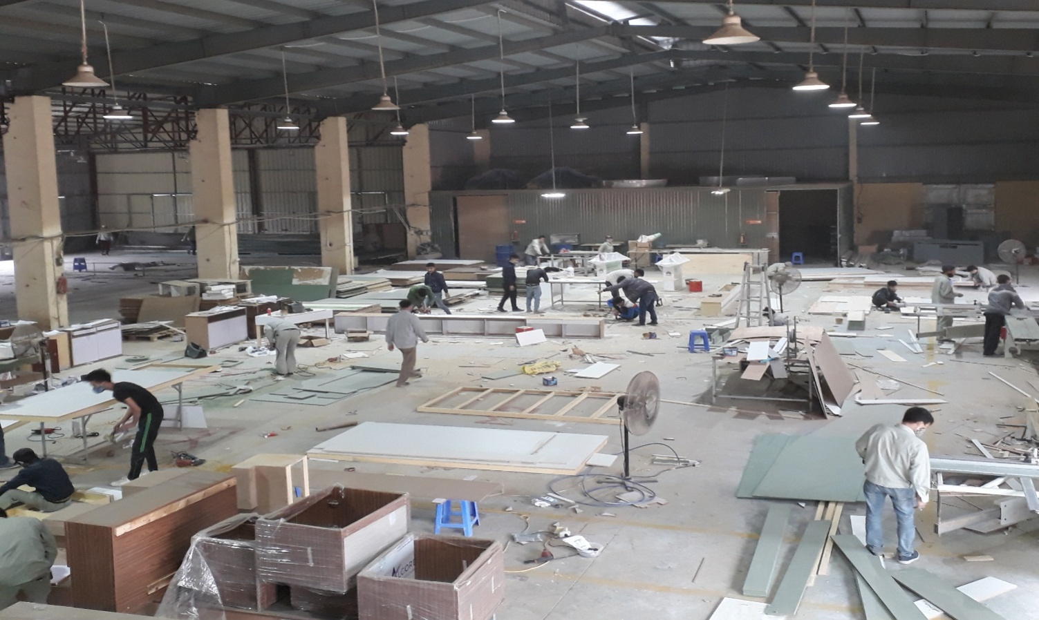
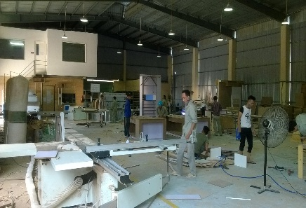
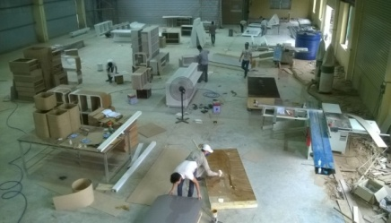
WORKSHOP INSIDE
Area: 3000m2
No of Workers: 80

Slide 5
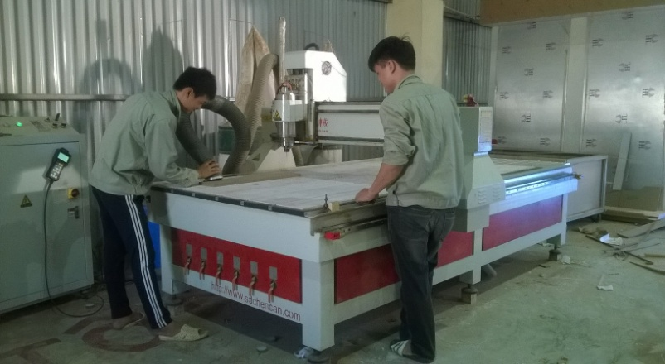
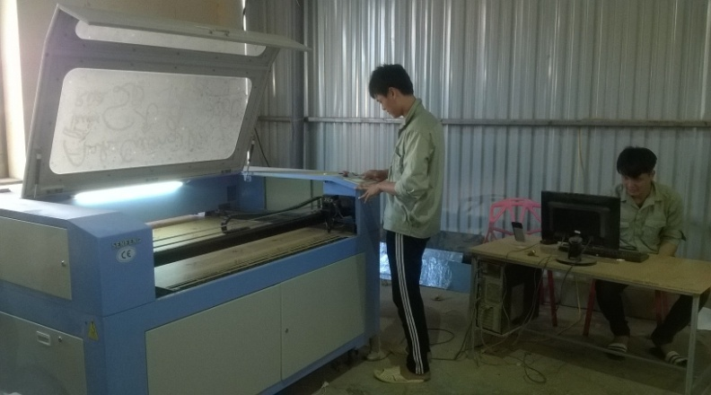
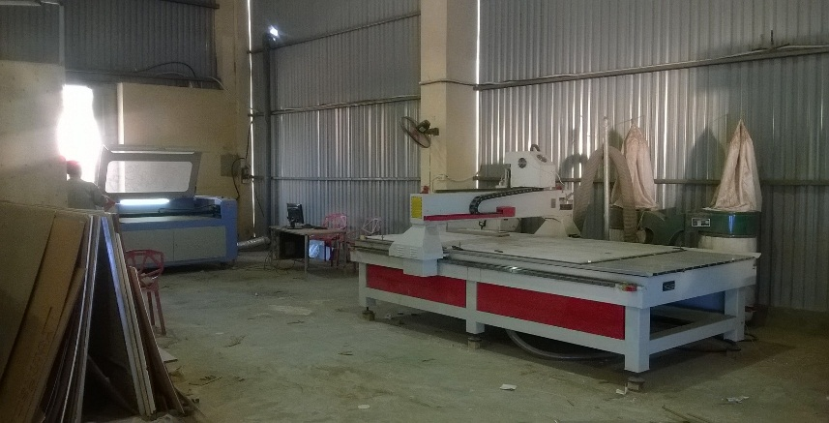
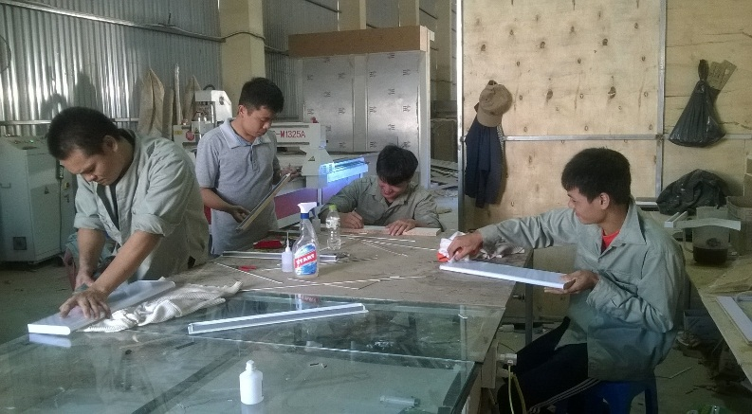
MACHINE
The high-tech zone contains more modern machines, including: CNC machine, Lazer machine, acrylic bending machine, acrylic polishing machine,… Together with skilled – experienced workers to make great production.
CNC Cutting Machine
Laser Cutting Machine
High Technical Processing Zone
Acrylic Finishing Team

Slide 6
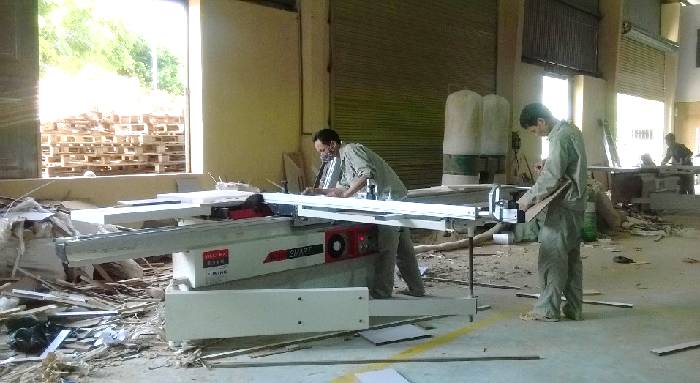
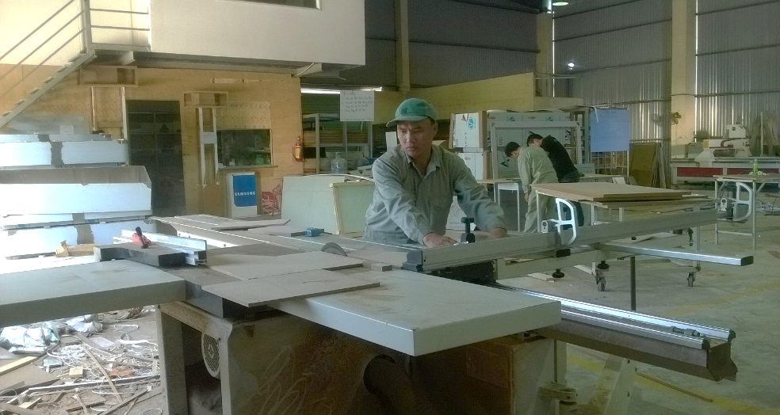
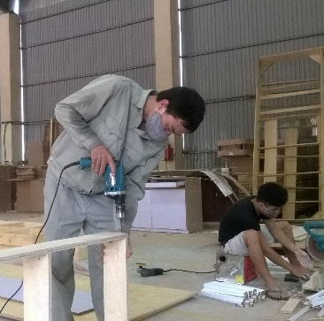
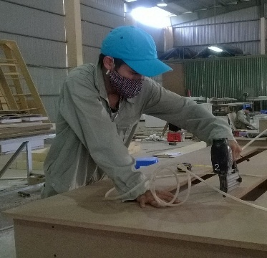
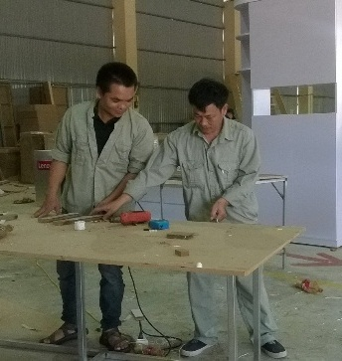
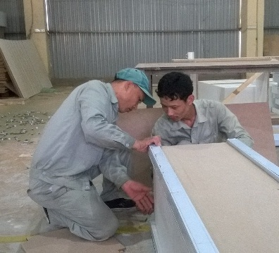
WOOD PROCESSING ZONE
Wood Cutting Machine 45º
Wood Cutting Machine 90º
Fully machine and working tools to ensure the producing at the high quality.
Khu Công nghệ cao
Experience Workers

Slide 7
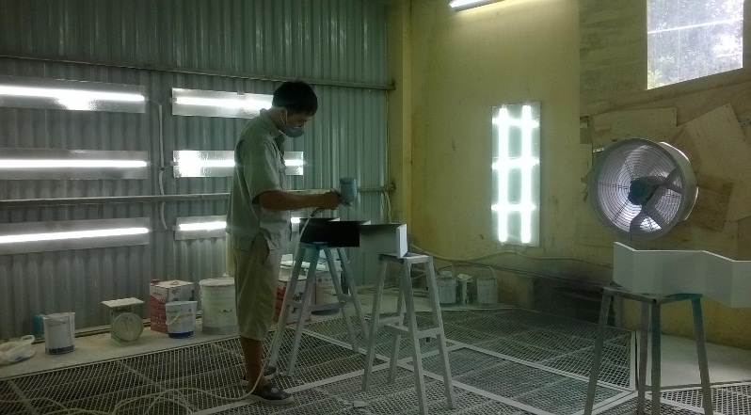
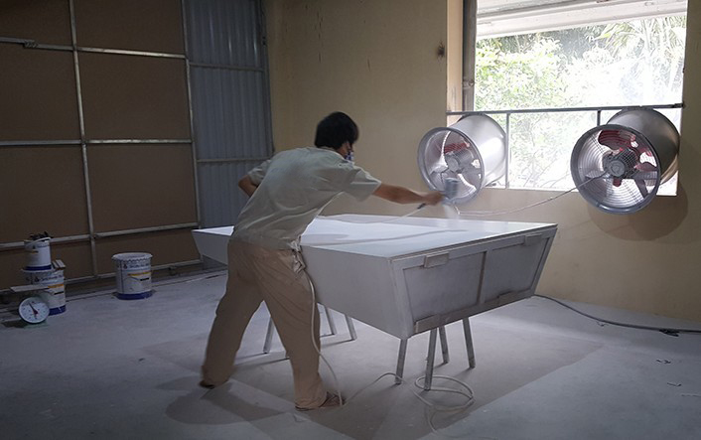
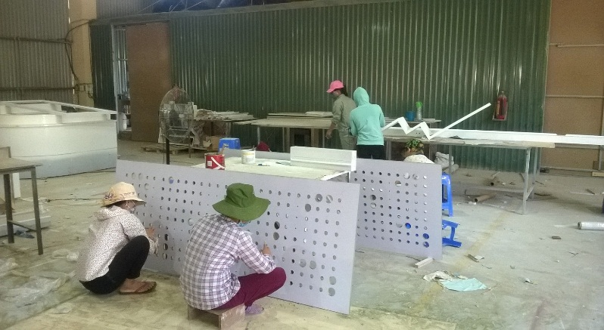
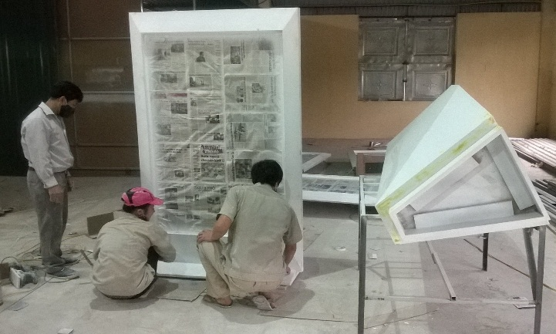
PAINTING AREA
In order to improving production quality, our company always keeps researching and investing in High Quality Painting Room. It follows strictly to current modern standard, including: dust filter, deodorant, light, ventilation, suitable with environment and products, especially weather conditions. Painting process was controlled carefully from paint type, filtering, roughening, sanding, baiting, ... to the pre-test before painting.
High quality Painting Room
Experienced Painting Workers
Finishing Team
QC Team

Slide 8
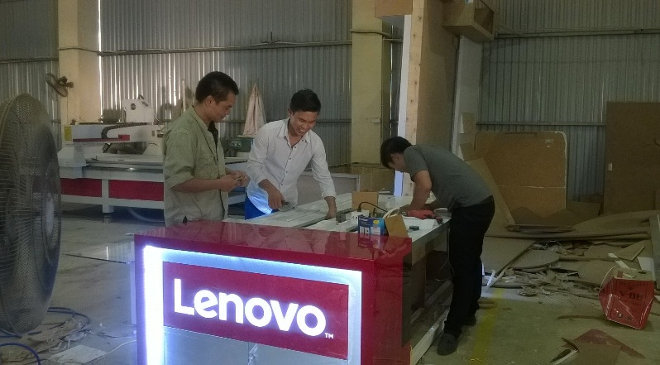
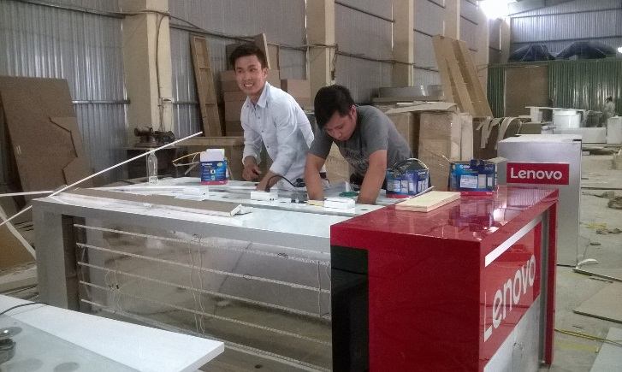
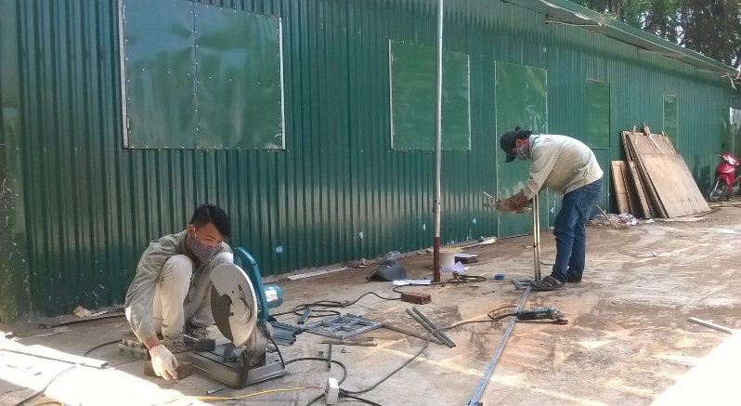
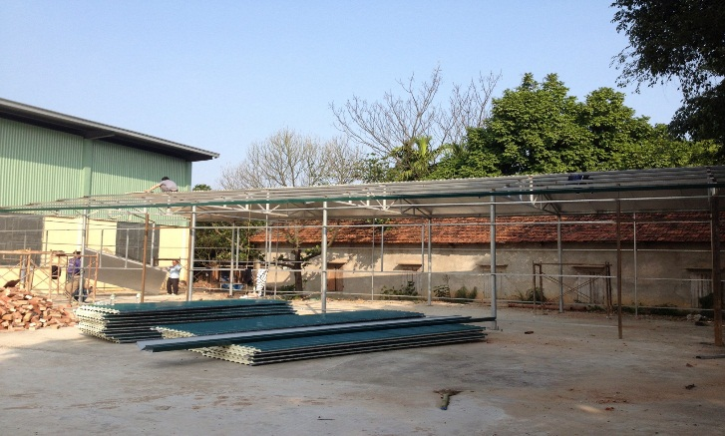
PRODUCT FINISHING AREA
Besides some main processing teams as carpenters, painters, assemblers,…in order to finishing some specific furniture, we also focus on iron, electricity, promotion to make a great work.
Installation Team
Electric Team
Steel Process Team

Slide 9
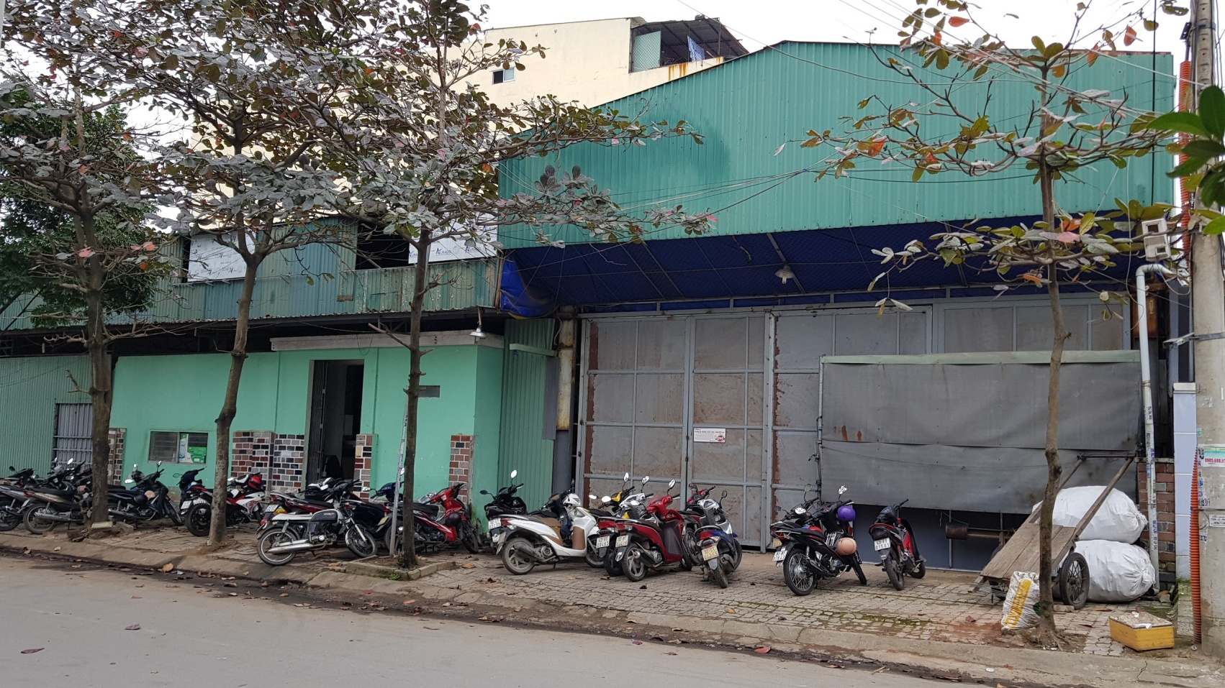
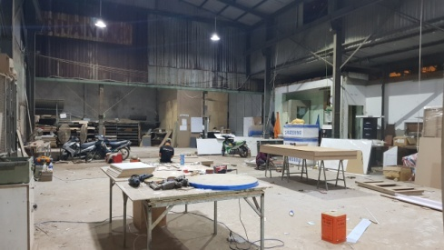
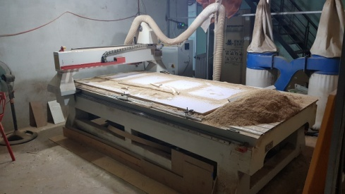
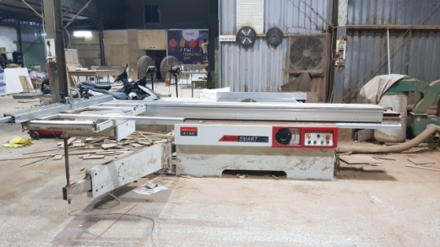
DANANG WORKSHOP

Slide 10
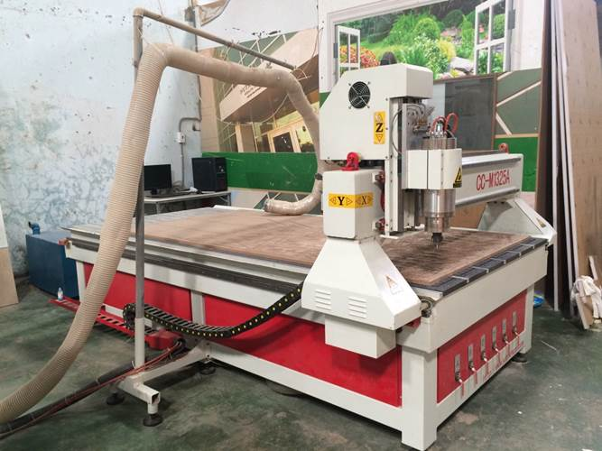
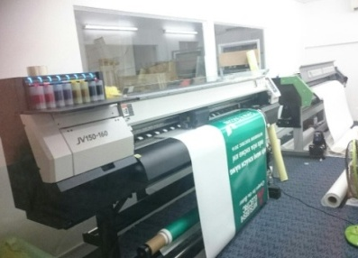
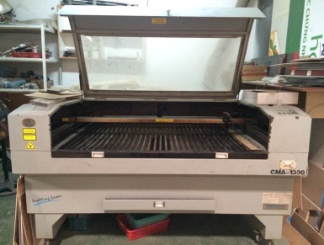
HCM WORKSHOP

Slide 11
PROJECT HIGHLIGHT

Slide 12
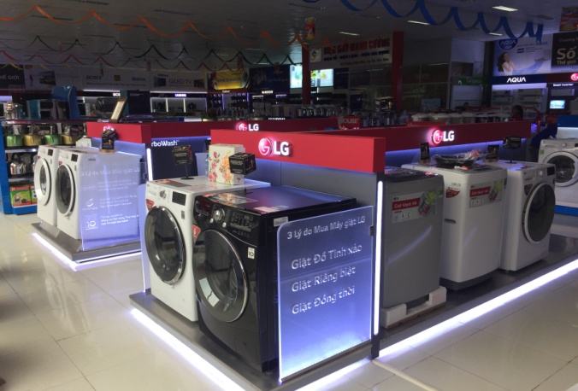
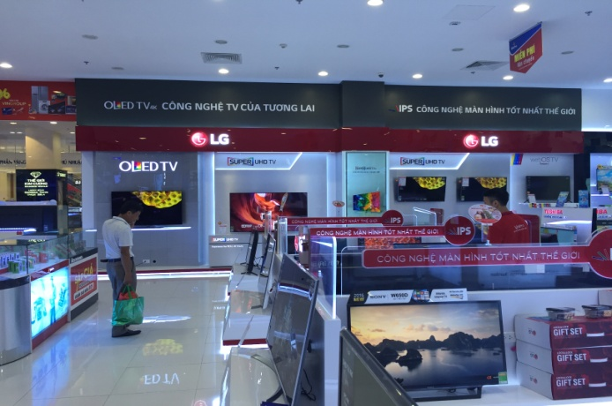
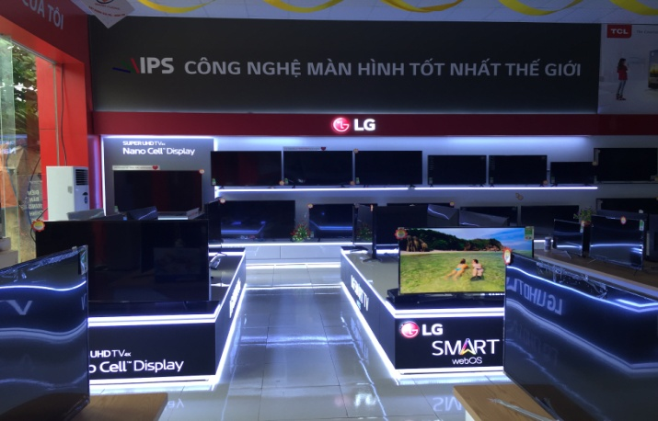
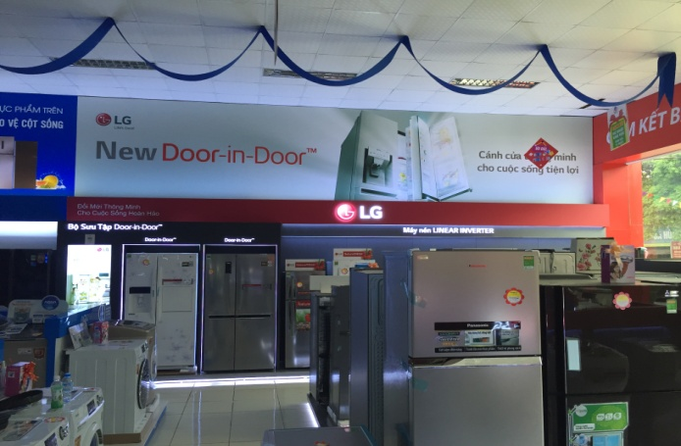
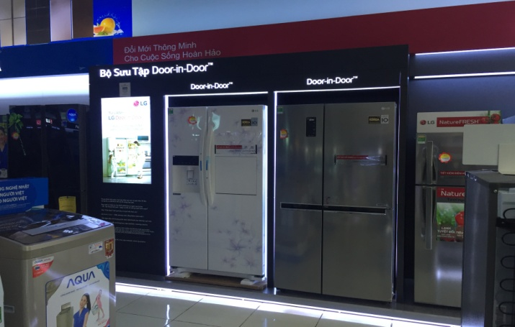
VALUED CLIENTS

Slide 13

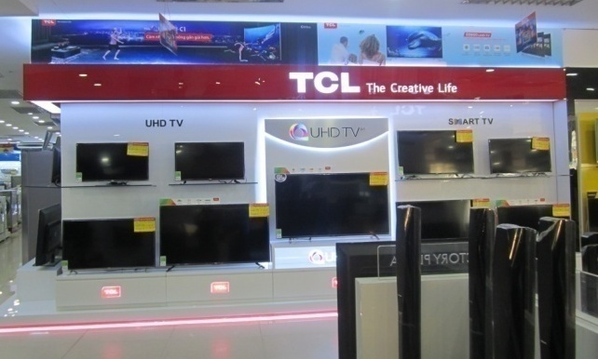
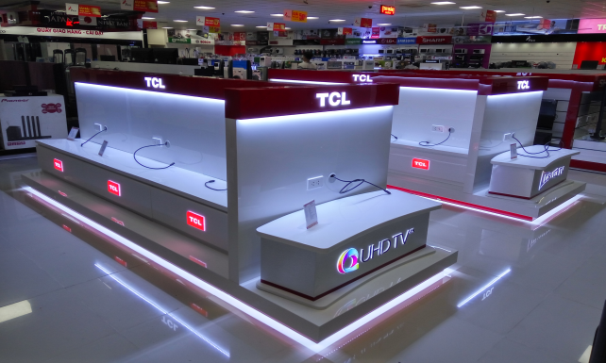


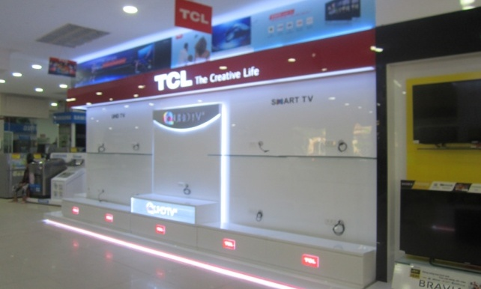
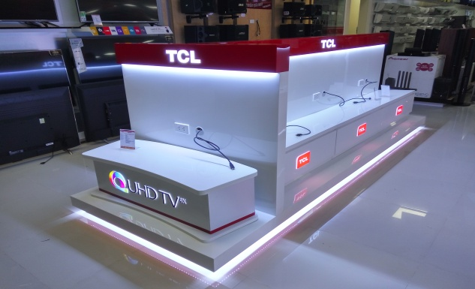
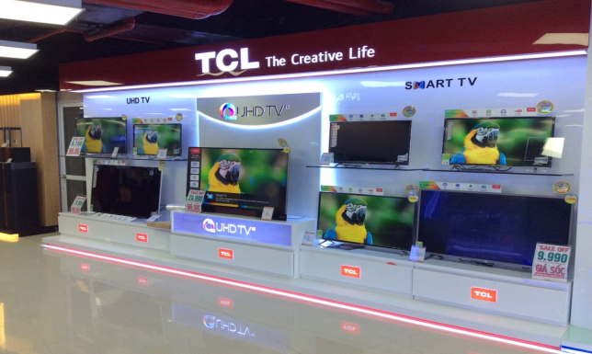
VALUED CLIENTS

Slide 14
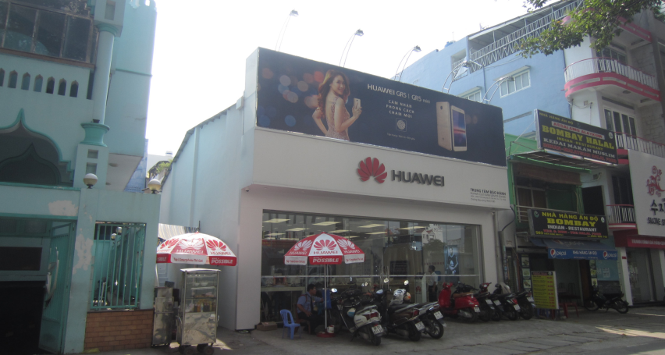
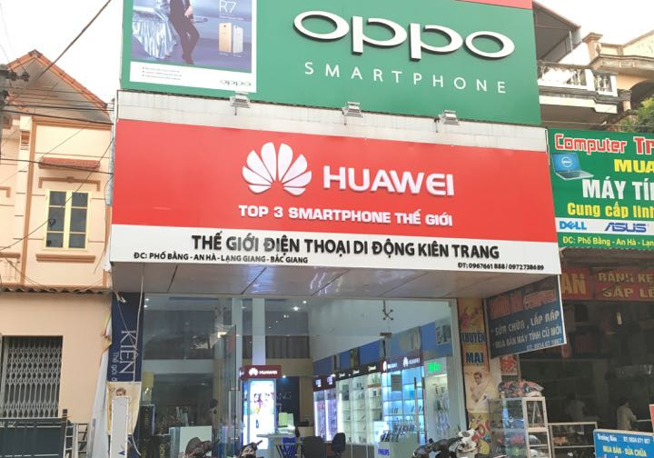
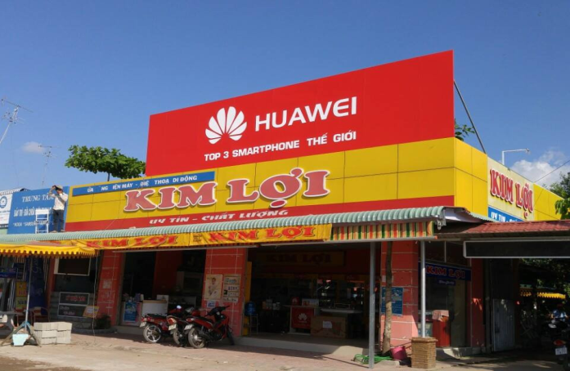

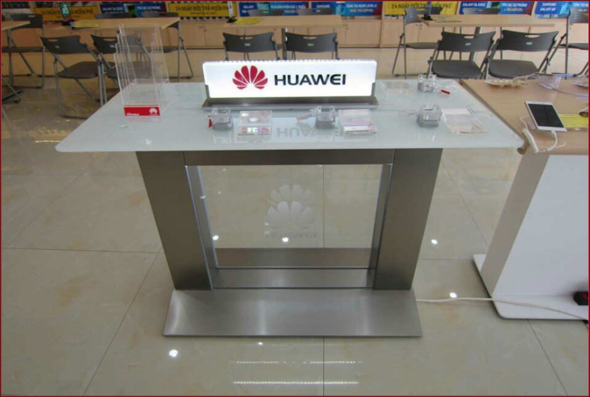
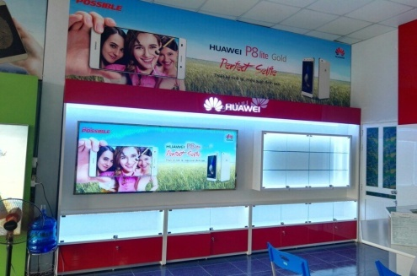
VALUED CLIENTS

Slide 15
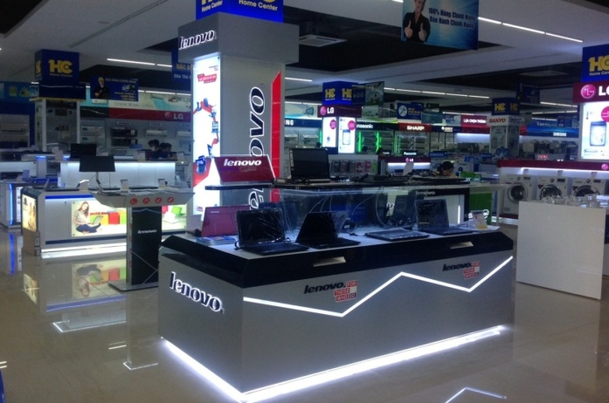
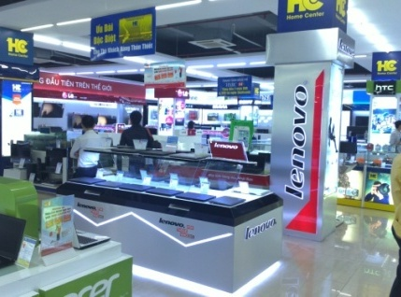
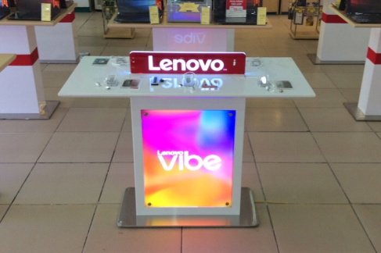
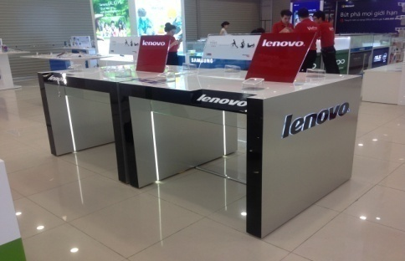
VALUED CLIENTS

Slide 16
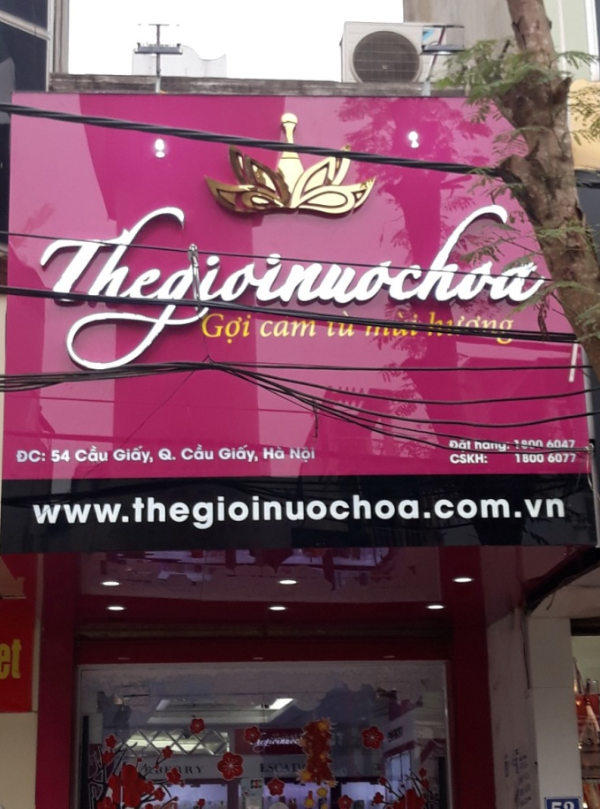
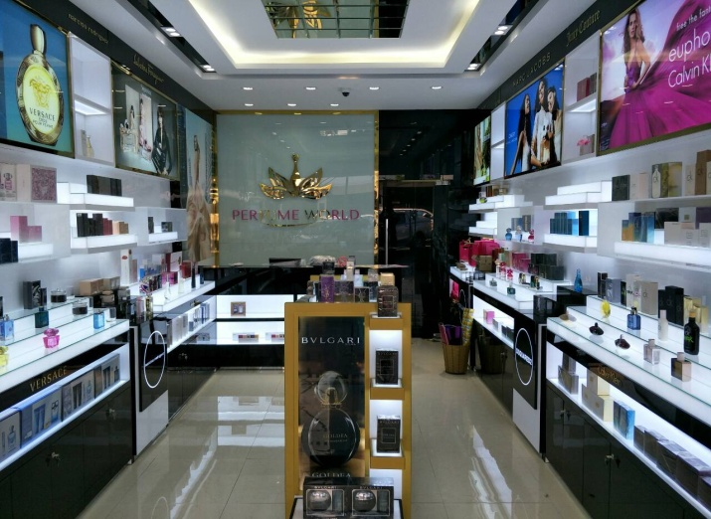



VALUED CLIENTS

Slide 17





VALUED CLIENTS

Slide 18






VALUED CLIENTS

Slide 19







VALUED CLIENTS

Slide 20







VALUED CLIENTS

Slide 21







VALUED CLIENTS

Slide 22




VALUED CLIENTS

Slide 23




VALUED CLIENTS

Slide 24







VALUED CLIENTS

Slide 25




VALUED CLIENTS

Slide 26




VALUED CLIENTS

Slide 27



VALUED CLIENTS
Thiết kế & Thi công nội thất gia đình

Slide 28
CONTACT US
Main Office: Km14 Thang Long Avenue – Song Phượng Ward– Hoài Đức District – Hanoi
Email : thangqt@thl.com.vn
Tel : 024 3200 5770
Hotline : 091 355 1184

